Slide 1



Nanocrystalline opportunities in wireless
charging systems
Abhilash Kamineni Utah State University

Slide 2
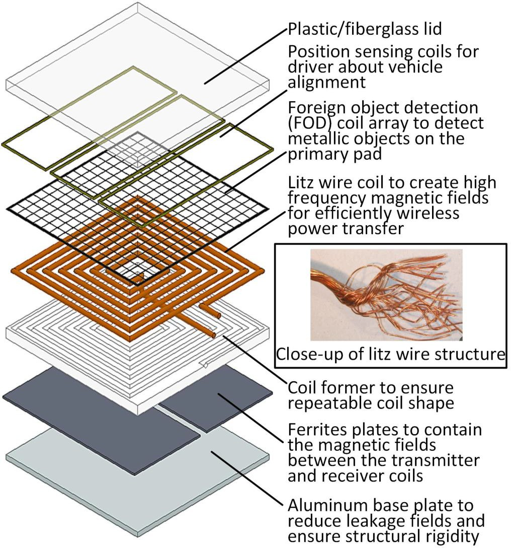
Challenges with wireless charging
A wireless charging system can be thought of as a dual active bridge with a loosely coupled transformer and resonant network on both the primary and secondary windings
Coupling varies between 0.1 to 0.3
Wireless charging coils create 3D magnetic fields
Improperly placed nanocrystalline cores will create
high eddy current losses
Vehicle OEMs want smallest possible footprint, low weight, and low cost
2

Slide 3
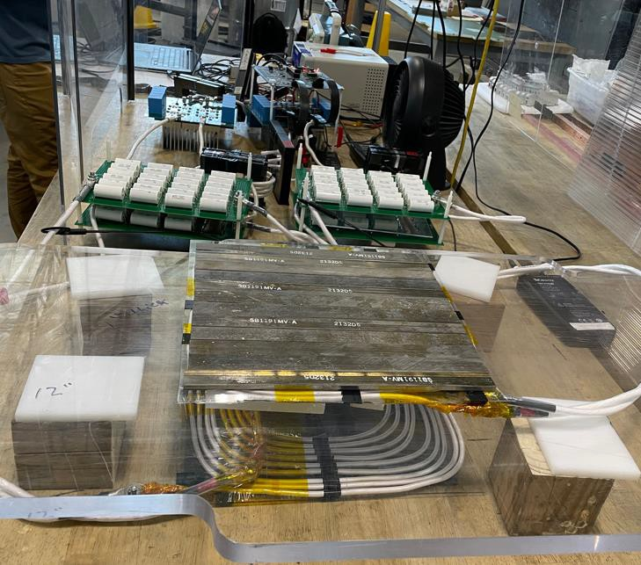
Feasibility study of nanocrystalline cores in WPT
Developed a 7kW prototype wireless charging system with a nanocrystalline cores and compared it to ferrite
Key takeaways:
Nanocrystalline cores can outperform ferrite solutions (higher efficiency and coupling)
The 2D field restriction makes designing compact coils challenging compared to ferrite cores, especially when operating under misaligned conditions
Nanocrystalline bar-shaped structure
Project funded by CBMM
5mm height
25mm width
320mm length
3

Slide 4
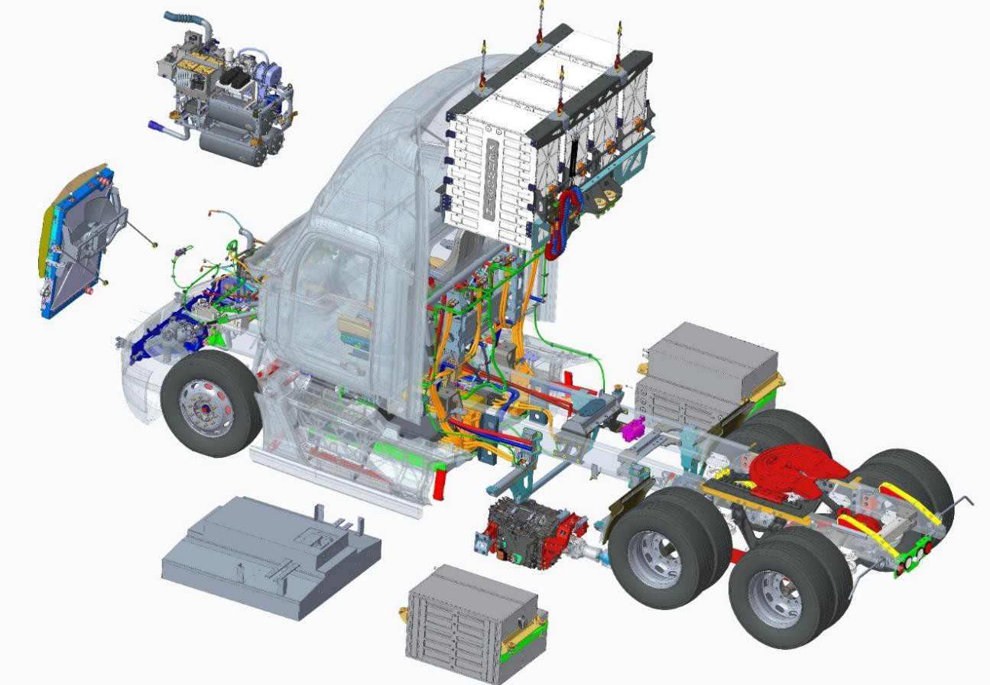
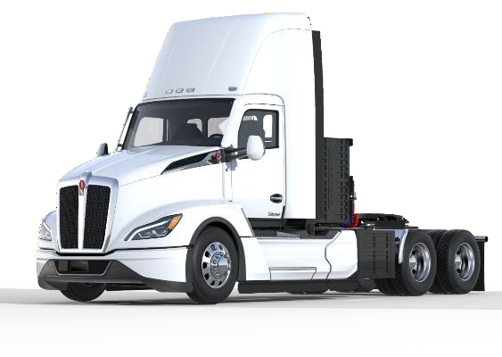
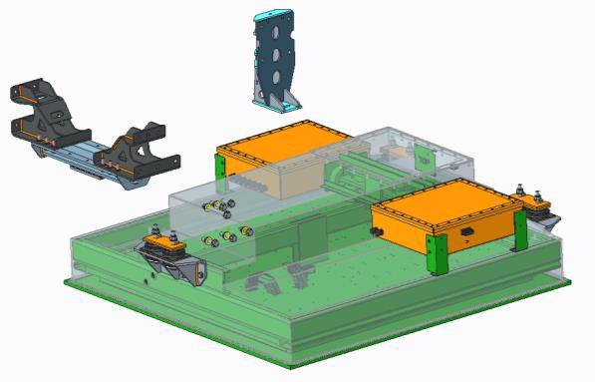
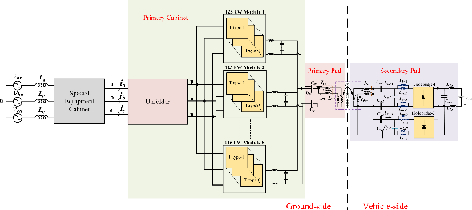
WPT for HD vehicles
Project Falcon: DOE VTO ELT262: Long-Range Battery Electric Vehicle with Megawatt Wireless Charging
Power Electronics Cradle
4 HV Battery Towers
Cooling Module
Single HV Fan
2 HV Battery Side Packs
HV Battery Cooling
Weights
Batteries – 12,ooolbs Charge plate – 2,500lbs
Power Electronics Cradle - 770lbs
Finish Chassis – 25 to 27Klbs
Wireless 1MW Charge Plate
Traction Motor/Inverter/Transmission

Slide 5
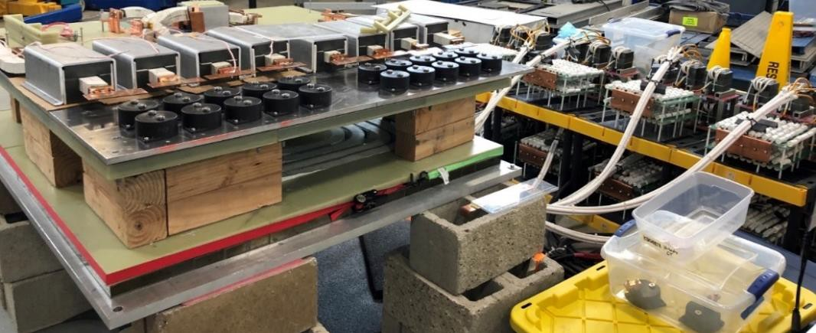
Challenges in high power wireless charging
High power wireless charging coils can consume a lot of ferrite
1MW wireless charging system requires 200- 350kg of ferrite cores
Cooling is challenging!
Impractical to get liquid cooling to the windings
Ferrite has low thermal conductivity
Nanocrystalline cores can help:
Reduce core volume and weight
Act as a better material to transfer heat
Enclosure
 |  | Copper (litz)
 |  | Ferrite
Cold Plate
 | Power Electronics

Slide 6
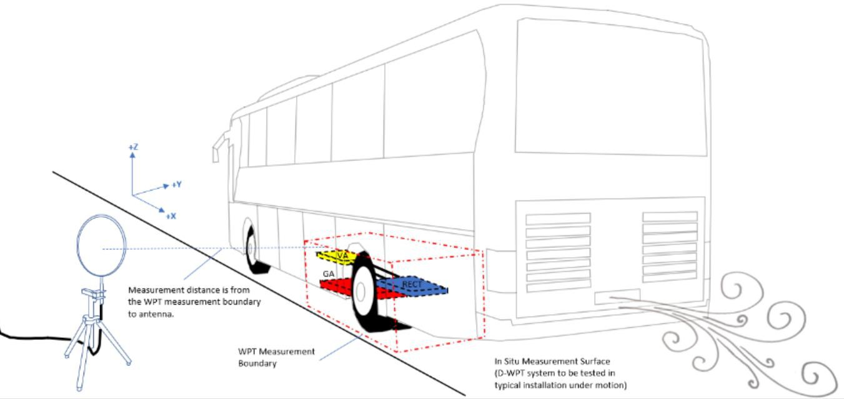
Shielding
B-field limited to 15uT at the edge of the vehicle
Use nanocrystalline ribbons as a cost effective way to absorb stray fields at the side of the vehicle
Lower stray fields means we can push more power or operate with wider misalignment
SAE J2954/2

Slide 7
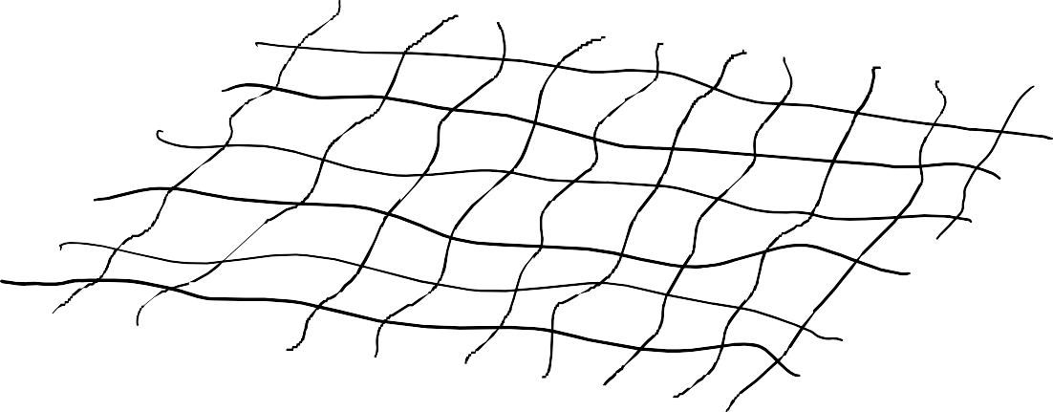
Fractured ribbon structures
A fractured ribbon structure can would reduce in-plane performance but also reduce eddy current losses due to 3D fields
Can potentially simplify the manufacturing process

Slide 8
What WPT researchers need
Premade nanocrystalline block cores that we can purchase
I can currently purchase the following ferrite shapes with ease:
10mm x 10mm x 2mm
25mm x 25mm x 5mm
50mm x 50mm x 5mm
100mm x 100mm x 5mm
And many more
Gives researchers flexibility to explore design options
If we had similar products available for nanocrystalline cores then we can develop designs with ease
Researchers will help manufactures determine what the optimal shapes should be

